Slide 1

TypeScript
By Hassan alshamrani

Slide 2
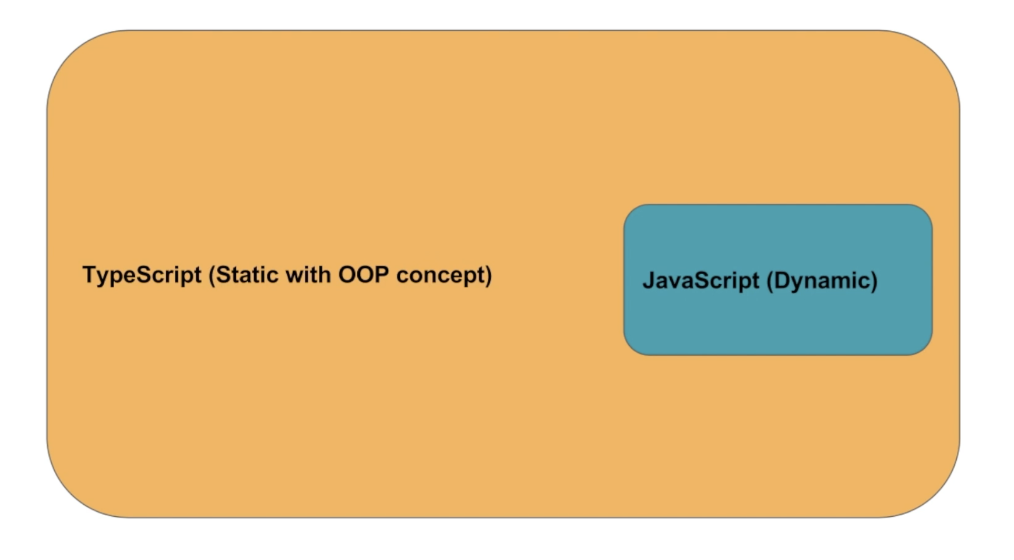
What is TypeScript ?
TypeScript is an open-source programming language developed and maintained by Microsoft. It is a strict syntactical superset of JavaScript, and adds optional static typing to the language. TypeScript is designed for development of large applications and transcompiles to JavaScript.
Notes:
TypeScript is a superset of the JavaScript programming language. JavaScript, which is dynamically typed, TypeScript allows you to use static typing.

Slide 3
Installing typescript
There are two main ways to get the TypeScript tools:
Via npm (the Node.js package manager)
By installing TypeScript’s Visual Studio plugins

Slide 4
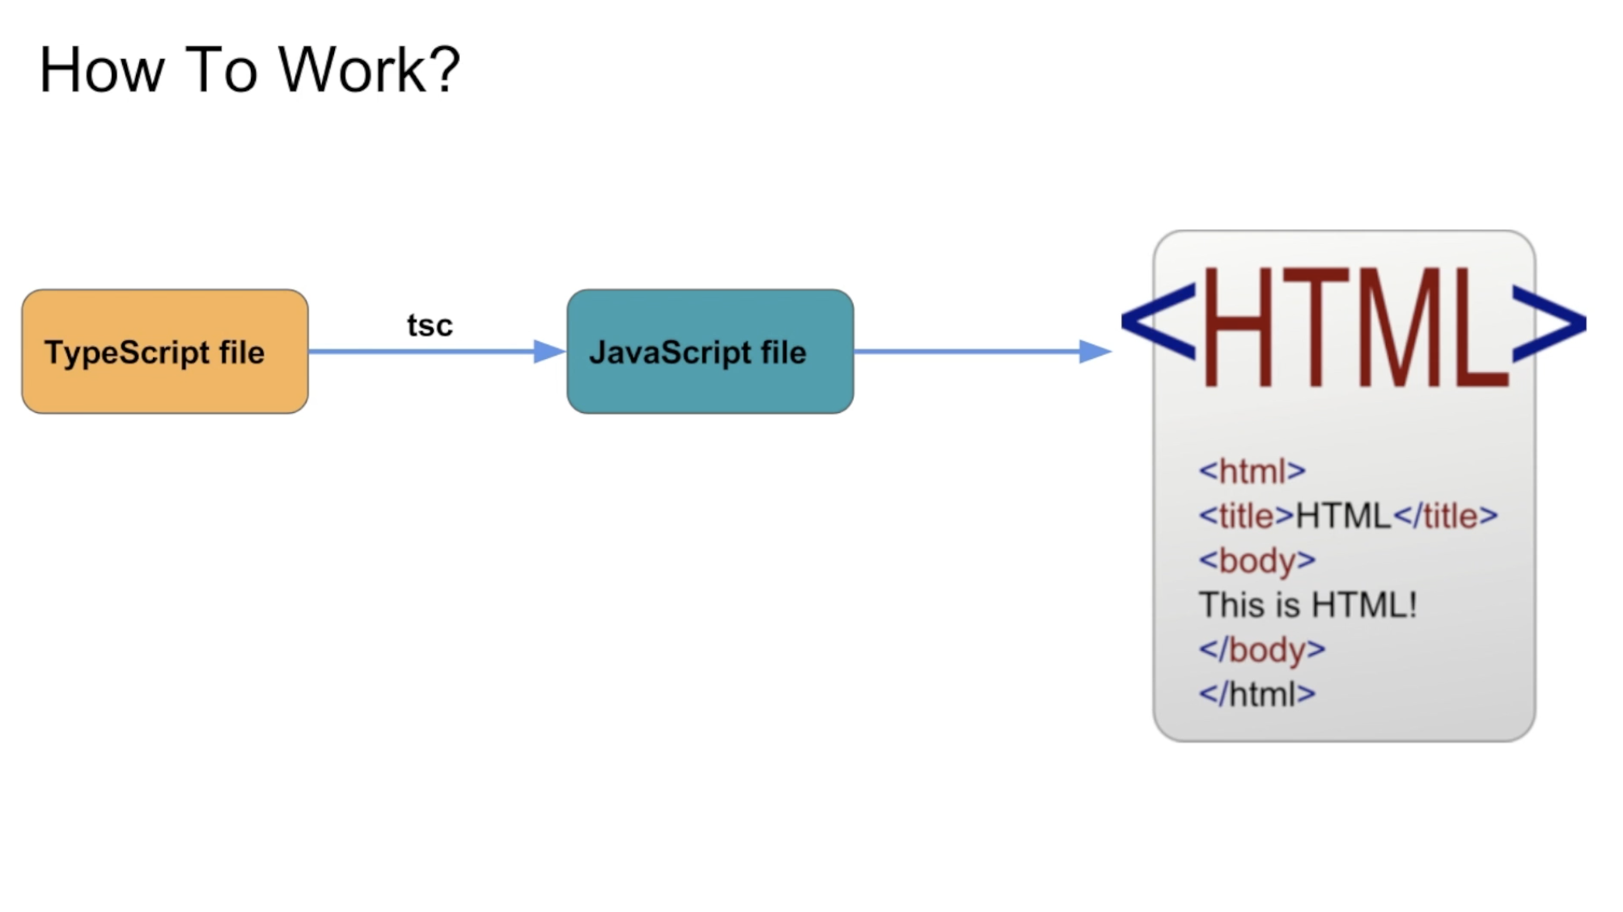
How to work ?
Notes:
Let's say you have written some TypeScript code in a .ts file. Browsers won't be able to run this code by themselves. You will have to compile the TypeScript into plain JavaScript that can be understood by browsers.

Slide 5
The benefits of using TypeScript
Typescript has the ability to compile down to a version of JavaScript that runs on all browsers.
Writing clean, object-oriented code in JavaScript can be a bit difficult for anyone, even those with extensive experience in object oriented programming. Naturally, the complexity of the code increases as the size of the project grows. This is where Typescript wins over JavaScript - you can very easily write pure object-oriented code in Typescript with little knowledge.
Notes:
Optional static typing, with emphasis on optional ( it makes porting JavaScript application to TypeScript easy ) .

Slide 6
Why TypeScript writes cleaner JavaScript?
BECAUSE when type checking occurs. Static languages’ variables are type checked at compile time, with the added benefit that the compiler will spot any errors or bugs at this phase and reject the program.

Slide 7
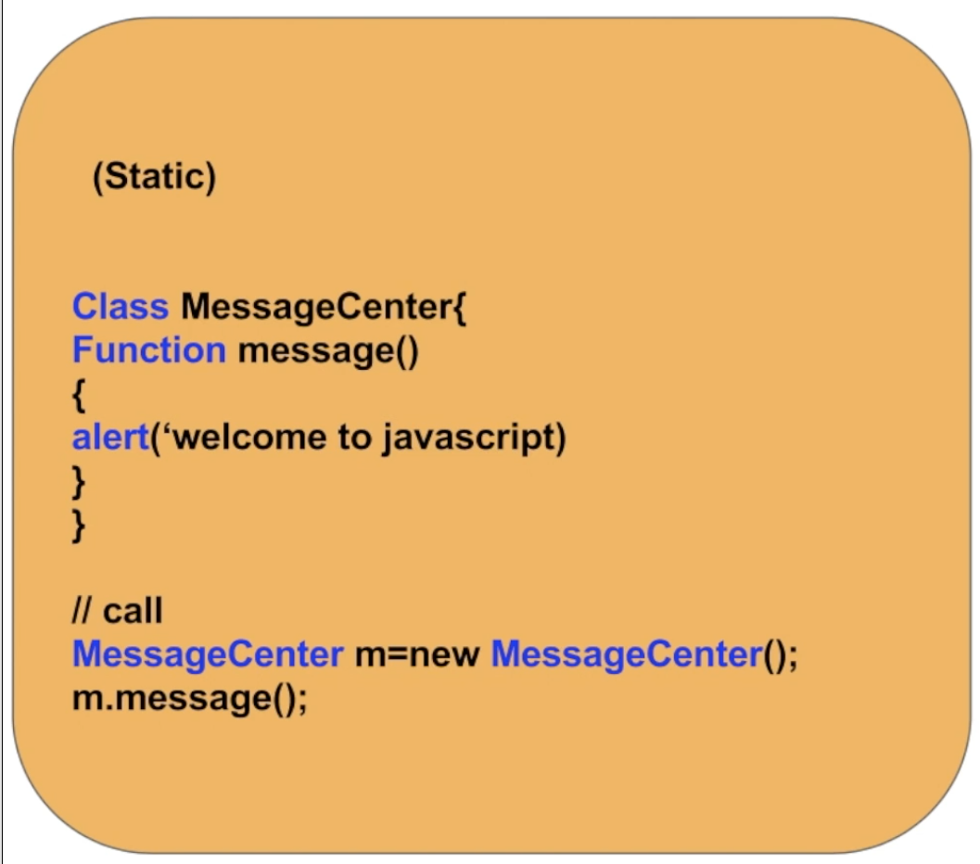
TypeScript ( Example )

Slide 8

WHY DO FRONT-END DEVELOPERS USE TYPESCRIPT ?
TypeScript is alternative to coding in “pure” JavaScript. Like many scripting languages, JavaScript has its quirks, and it can get verbose. The more code you write, the greater the chance that it can get tangled, repetitive, or buggy. This tool make writing JavaScript quicker, easier to read, cleaner, and scalable.
Notes:
THEY use it because it makes writing JavaScript quicker, easier to read, cleaner, and scalable.

Slide 9
Let’s try it

Slide 10
IN SHORT :
TypeScript to Write Easier, Faster, and Cleaner JavaScript

Slide 11
Thank You for Listening have a nice weekend
By Hassan Alshamrani

Slide 12
references
https://www.quora.com/What-are-the-advantages-of-using-TypeScript
https://www.upwork.com/hiring/development/typescript-coffeescript-two-tools-to-write-faster-cleaner-javascript/
….

